Slide 1
AP Statistics Section 9.1 Distribution of Sample Means

Slide 2
What’s Important:
This lesson is the introduction to “inference” – using your samples to make estimations about the population
Ie: suppose we don’t know the population mean, so we take samples to ‘estimate’ the population mean
Introduction to the concept of “distribution of sample means” or “sampling distribution”
We take a bunch of samples of fixed sample size “n”, use the sample means to create a density curve
This density curve is a distribution of all possible averages from sample size “n”
Central Limit Theorem: the distribution of the sample mean is normally distributed [Note: Certain conditions MUST apply!!]
Parameter: terms that are used to describe the Population
Statistics: Terms that are used to describe a “Sample”

Slide 3

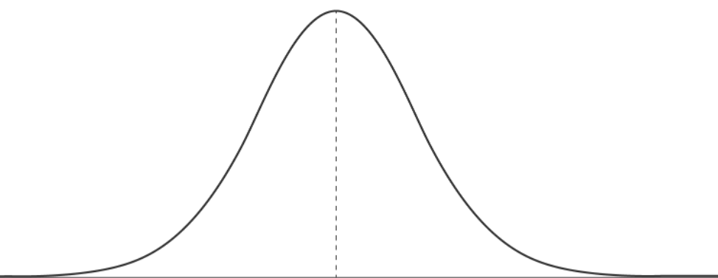

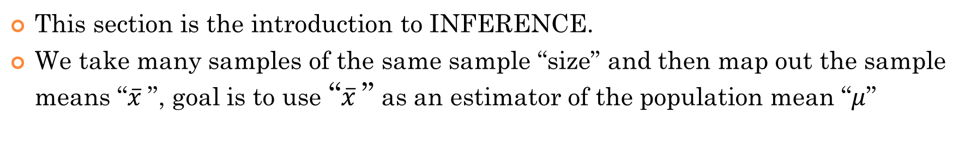
What is a Distribution of Sample Means?
This section is the introduction to INFERENCE.
We take many samples of the same sample “size” and then map out the sample means “$\overline{x}$”, goal is to use “$\overline{x}$” as an estimator of the population mean “$μ$”
Parameters:
Information about the population:
Suppose you want to find the average height of all males between 24 to 35 in N.A.
NOW, what if you took many samples of size 30, and mapped out the distribution of the averages. HOW would the distribution of these samples averages look like?
What you now have here is called a “DISTRIBUTION OF SAMPLE MEANS”
To get this true population mean, you will need to take a census of everyone
The mean of the “distribution of the sample mean” is equal to the population mean!!
Each sample has the same size, but the averages won’t all be the same…… (so keep taking them samples!!!)

Slide 4
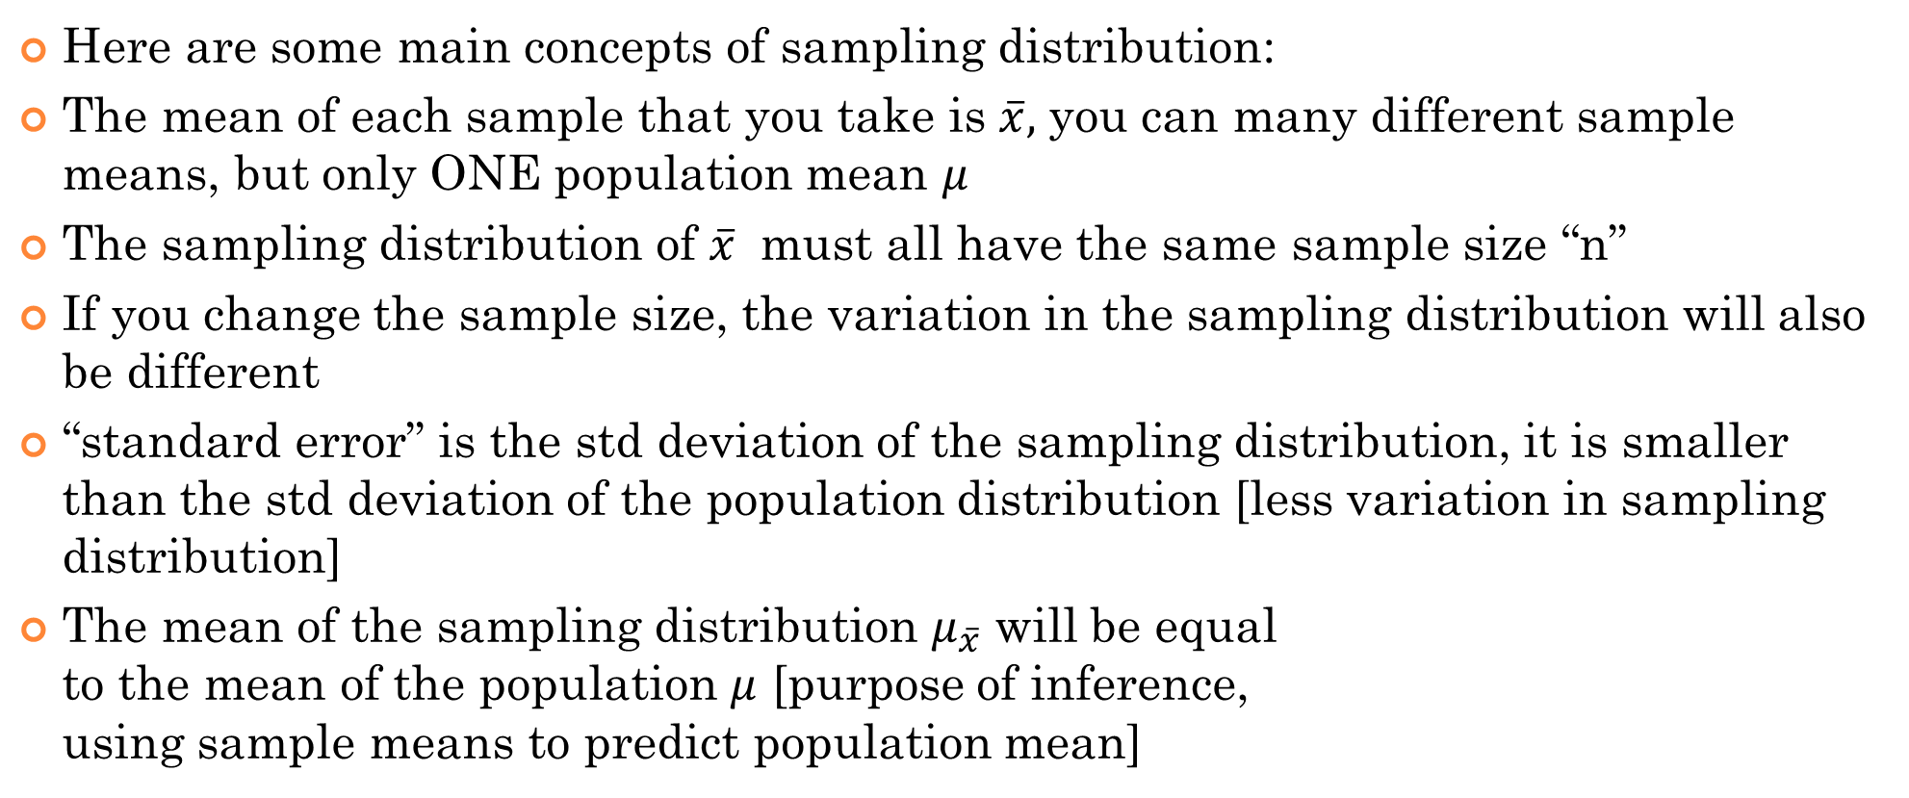
What’s Important in This Section?
Sampling Distribution: [Distribution of Sample means] distribution of all the possible sample means of size ‘n’ from the same population
Here are some main concepts of sampling distribution:
The mean of each sample that you take is $\overline{x},$ you can many different sample means, but only ONE population mean $μ$
The sampling distribution of $\overline{x}$ must all have the same sample size “n”
If you change the sample size, the variation in the sampling distribution will also be different
“standard error” is the std deviation of the sampling distribution, it is smaller than the std deviation of the population distribution [less variation in sampling distribution]
The mean of the sampling distribution $μ_{\overline{x}}$ will be equal to the mean of the population $μ$ [purpose of inference, using sample means to predict population mean]

Slide 5
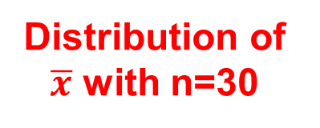
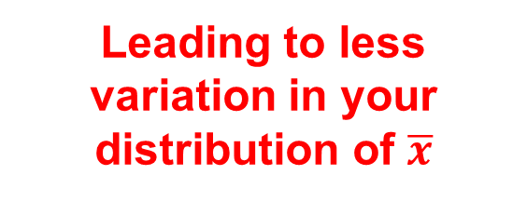
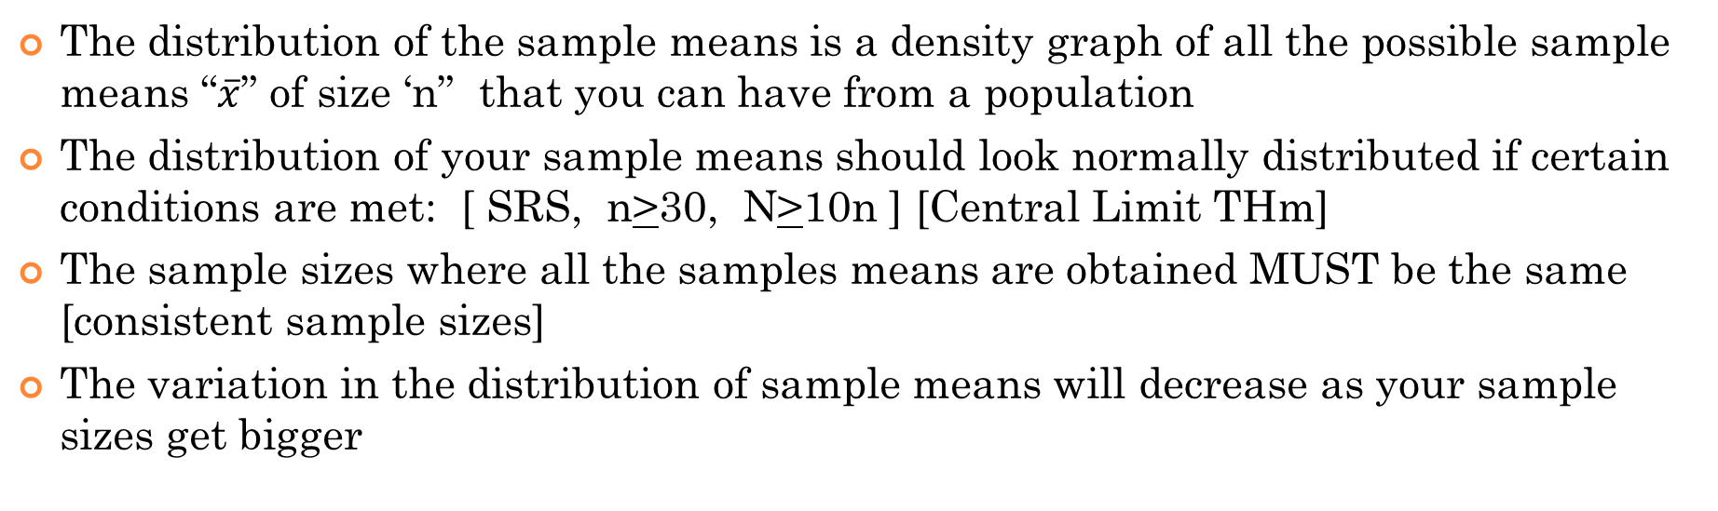

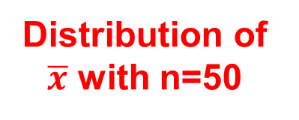
What is a Distribution of Sample Means?
The distribution of the sample means is a density graph of all the possible sample means “$\overline{x}$” of size ‘n” that you can have from a population
The distribution of your sample means should look normally distributed if certain conditions are met: [ SRS, n>30, N>10n ] [Central Limit THm]
The sample sizes where all the samples means are obtained MUST be the same [consistent sample sizes]
The variation in the distribution of sample means will decrease as your sample sizes get bigger
Standard error
Distribution of $\overline{x}$ with n=30
With a bigger sample size, your sample means will be closer to your population mean
Distribution of $\overline{x}$ with n=50
Population:
Population:
Leading to less variation in your distribution of $\overline{x}$

Slide 6
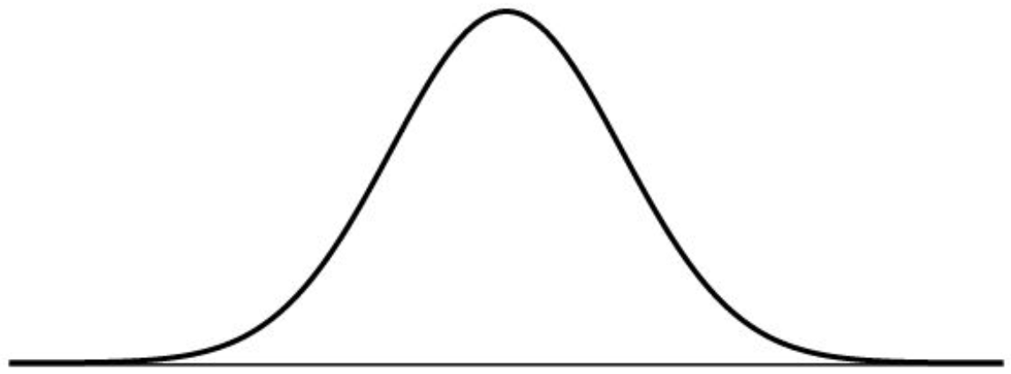
I) TERMS: Parameters vs Statistics
Anything about the POPULATION is called a “Parameter”
Anything about your SAMPLES is called a “Statistics”
Variations will exist in the statistics from each sample
Parameters:
Information about the population:
Statistics: information about your samples
Distribution of Statistics:

Slide 7
What do you know about the distribution of SAMPLE MEANS?
In order to use our theories on the distribution of sample means, here are some conditions:
1. The samples you take MUST be a RANDOM sample from the population
A random sample prevents bias, over/under representation
2. The sample sizes MUST the be SAME SIZE. The sample size will affect the variation of the distribution of sample means
What we know about the distribution of Sample Means:
1. Depending on the population distribution OR sample size, the distribution of sample means is “Normally Distributed” (Central Limit Theorem)
2. The variation in the distribution of sample means is SMALLER than the variation of means in the population
3. The mean from the distribution of sample means is EQUAL to the population mean!! (THIS one is HUGE!!)

Slide 8


Slide 9
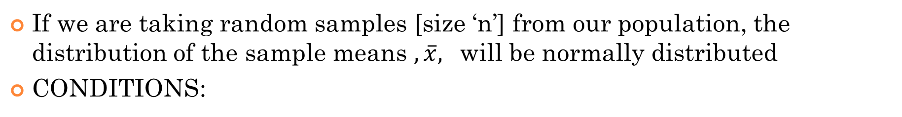
Central Limit Theorem:
If we are taking random samples [size ‘n’] from our population, the distribution of the sample means $,\overline{x},$ will be normally distributed
CONDITIONS:
SIMPLE Random Samples [SRS]: Every sample taken must be randomly chosen, no particular subset of the population is favored in your samples
Independent Samples: the individual observations or data points in the sample must be independent of each other. This means that the occurrence or value of one observation should not affect the occurrence or value of another
Sample Size: if the population is not normally distributed, the sample sizes must be 30 or more in order for the sampling distribution to be normally distributed. If population distribution is “normal”, then sample size can be any size

Slide 10
Does population distribution matter?
POINT #1) If your population distribution is “normal” [bell curve], the distribution of your sample means will also be normal [bell curve]
https://www.statcrunch.com/applets/type3&samplingdist
POINT #2) If your population distribution is NOT “normal” [bell curve], the distribution of your sample means will also be normal [bell curve] if your sample sizes are 30 or more {Central Limit THm}
Ie: The population distribution can be “bimodal”, “uniform”, skewed, “tri-modal”, as long as sample size is 30 or more, the distribution of sample means will be normal [bell curve]
From these two points, you will need to always check either if the population is normally distributed OR if the sample size is 30 or greater
This is important because if neither conditions are met, the sampling distr. will not be ‘normal’, can’t calculate any probabilities…..

Slide 11
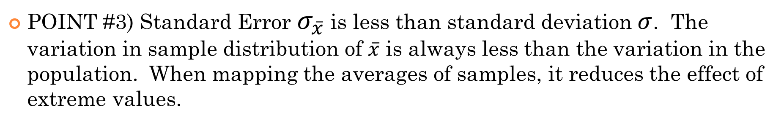
HOW to Find the STD Dev & Variance in the distribution of Sample means:
POINT #3) Standard Error $σ_{\overline{x}}$is less than standard deviation $σ$. The variation in sample distribution of $\overline{x}$ is always less than the variation in the population. When mapping the averages of samples, it reduces the effect of extreme values.
POINT #4) FORMULA: [CONDITION: N $≥10n$]
The std dev. of your sampling distribution is equal to the population std dev. divided by the sq root of the sample size
IF SAMPLE SIZES increase, the variation in the distribution of sample means will get
SMALLER!!!
Sample size must be less than 1/10th of the Population size
Condition for using std dev. formula
If your sample size is TOO BIG compared to the population, distribution of sample means will be too small, won’t be normally distributed!

Slide 12
The curve below is the population distribution for the heights of grade 12 students in BC. Suppose we take samples of size 25 and then calculate the averages [sample means]. Which of the choices below is the distribution of the sample means?
A)
B)
C)
D)

Slide 13
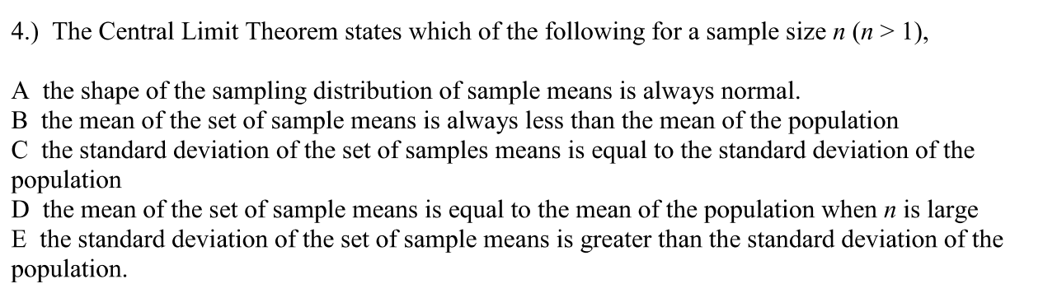

Slide 14
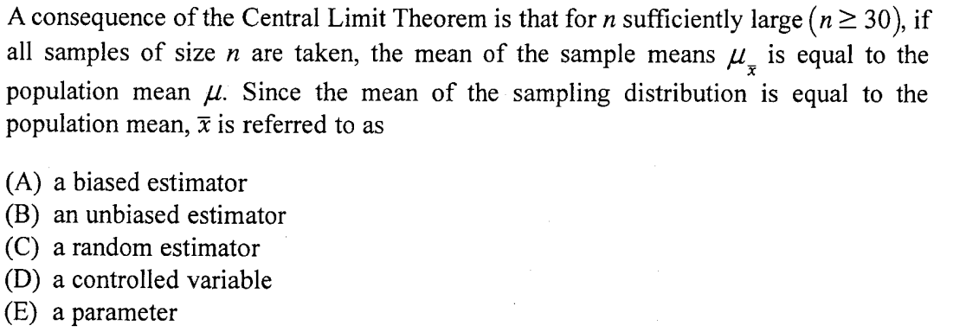

Slide 15
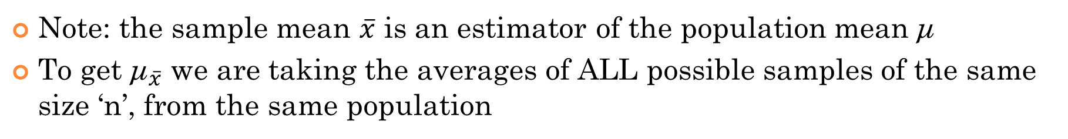
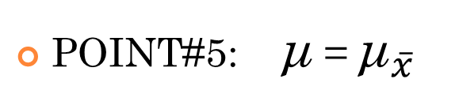
Distribution of Sample Means is EQUAL To population mean:
The population average is known as the parameter: μ
The average from one sample is known as a statistics: $\overline{x}$
The average from the distribution of “sample means” is known as: ${\text{μ}}_{\overline{x}}$
POINT#5: μ = ${\text{μ}}_{\overline{x}}$
Population MEAN = Average of distr. “sample means”
Note: the sample mean $\overline{x}$ is an estimator of the population mean μ
To get ${\text{μ}}_{\overline{x}}$ we are taking the averages of ALL possible samples of the same size ‘n’, from the same population
This point can be easily proven mathematically using probability methods
Let’s pretend we don’t know this….. The activity on the next page explores this concept:

Slide 16
Activity: AVG of Sample Means → Population Mean
Suppose a POPULATION consist of 8 people and each person has score of: 10, 11, 12, 13, 14, 15, 16, and 17. A sample of 3 people is to be taken from this population and their mean calculated.
a) How many different sample are possible
b) How many different sample means are possible?
c) Draw a frequency distribution of sample means. (Histogram)
d) What is the AVERAGE of all the sample means?
e) What is the population mean? Is it equal to the “average of all the sample means”?

Slide 17
a) There are 8 numbers and 3 numbers in each group.
b)
&
c)
There are 56 different samples possible

Slide 18
c) Frequency Distribution of Sample Mean:
Mean | Frequency
11 | 1
11.33333 | 1
11.66667 | 2
12 | 3
12.33333 | 4
12.66667 | 5
13 | 6
13.33333 | 6
13.66667 | 6
14 | 6
14.33333 | 5
14.66667 | 4
15 | 3
15.33333 | 2
15.66667 | 1
16 | 1
Sample Mean vs Frequency
6
5
4
Frequency
3
2
1
x
Sample Mean:
d)
The average of all the sample means:
They are equal!
When the take the average of all the sample means that are possible, it will be equal to the population mean
e)
Population mean:

Slide 19
How do we use the distribution of sample means?
1. The distribution of sample means can be used to predict the probability that you will get certain sample averages
Ie: What is the probability that I will get a sample average of 6ft or more if we take a sample of size 50 from the population of males in North America
Some sample averages are MORE likely to be obtained than others…..
If you take a random sample, you are more likely to get an average near the center than from afar…..
Population distribution
Distribution of Sample Means
https://onlinestatbook.com/stat_sim/sampling_dist/

Slide 20
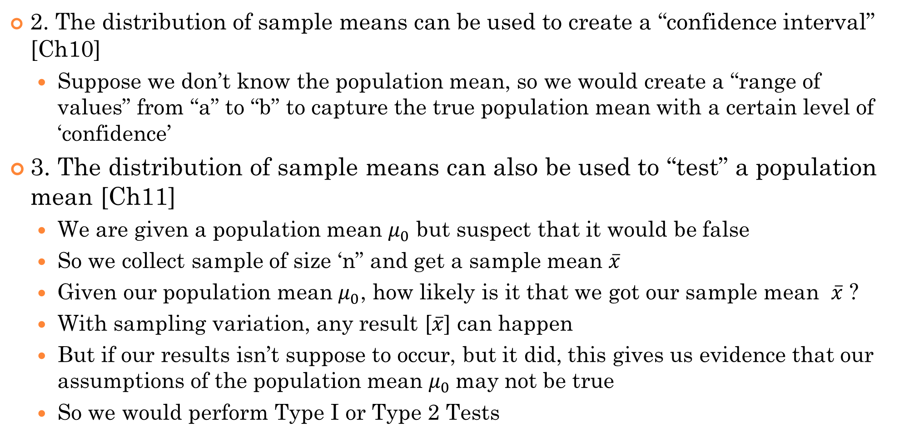
How do we use the distribution of sample means?
2. The distribution of sample means can be used to create a “confidence interval” [Ch10]
Suppose we don’t know the population mean, so we would create a “range of values” from “a” to “b” to capture the true population mean with a certain level of ‘confidence’
3. The distribution of sample means can also be used to “test” a population mean [Ch11]
We are given a population mean $μ_{0}$ but suspect that it would be false
So we collect sample of size ‘n” and get a sample mean $\overline{x}$
Given our population mean $μ_{0}$, how likely is it that we got our sample mean $\overline{x}$ ?
With sampling variation, any result [$\overline{x}$] can happen
But if our results isn’t suppose to occur, but it did, this gives us evidence that our assumptions of the population mean $μ_{0}$may not be true
So we would perform Type I or Type 2 Tests

Slide 21
Ex: Suppose the average annual income of UBC graduates at the 5 year mark is normally distributed with a mean of $120,000 and standard deviation of $15,000.
a) If you randomly selected a UBC graduate that worked for 5 years, what is the probability that they will earn more than $130,000
b) Suppose you randomly selected 36 UBC graduates that worked for 5 years, what is the probability that the average income of the sample is more than $130,000

Slide 22
Conditions for Sampling Distribution to be Normally Distributed:
TO use the distribution of sample means for probability purposes, the following conditions must be met:
1. Population is normally distributed or sample size is 30 or more
This is to ensure that the distribution of sample means will be normal
2. The population size is 10 times or more than the sample size
This is ensure that we can use the formula for variation and std deviation
If the sample is too big (more than 1/10 of population) then variation will be too small
3. The sample MUST be a simple random sample
This is to ensure that no part of the population is over/under represented
Otherwise population mean will not be equal to the mean of sampling distribution
Distribution could end up being skewed or the mean could be bigger or smaller
https://onlinestatbook.com/stat_sim/sampling_dist/

Slide 23
Ex: In 2010, 9264 students wrote the Euclid contest with a mean of 48.16 and standard Deviation of 17.212. The scores have a normal distribution
A). What is the probability that a single student randomly chosen from all those taking the test scores 80 or higher?
B) Now suppose we take all the possible SRS of 10 students who took the test. What is the mean and std deviation in the distribution of sample mean scores? Do your results depend on the fact that individual scores have a normal distribution?
C) What is the probability that the mean score of a SRS of 10 students is 80.5 or higher? Make sure the conditions for inference are met.

Slide 24
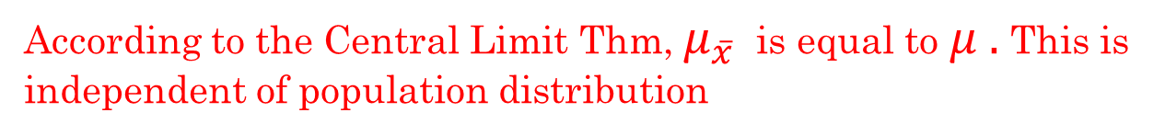
Ex: In 2010, 9264 students wrote the Euclid contest with a mean of 48.16 and standard Deviation of 17.212. The scores have a normal distribution
A). What is the probability that a single student randomly chosen from all those taking the test scores 80 or higher?
B) Now suppose we take all the possible SRS of 10 students who took the test. What is the mean and std deviation in the distribution of sample mean scores? Do your results depend on the fact that individual scores have a normal distribution?
The probability of choosing a single student at random whose test score exceeds 21 is about 3.22%
According to the Central Limit Thm, $μ_{\overline{x}}$ is equal to$μ .$This is independent of population distribution
Standard Error of the distribution of sample means
We can use this formula only if the population size is 10 times the sample size

Slide 25
C) What is the probability that the mean score of a SRS of 10 students is 80.5 or higher?
Before we calculate this probability, let’s first check if the conditions for using probability on sampling distributions are met:
1. Random sample: The sample is indicated as a SRS
2. Sample Size: The sample size is NOT 30 or more, but the population is normally distributed.
3. Population size is 10 times or more greater than sample size
There is a very small chance of 0.000000001416 that we would draw an SRS of 10 students whose average score exceeds 80.5
This sample average would very unlikely occur by chance!

Slide 26
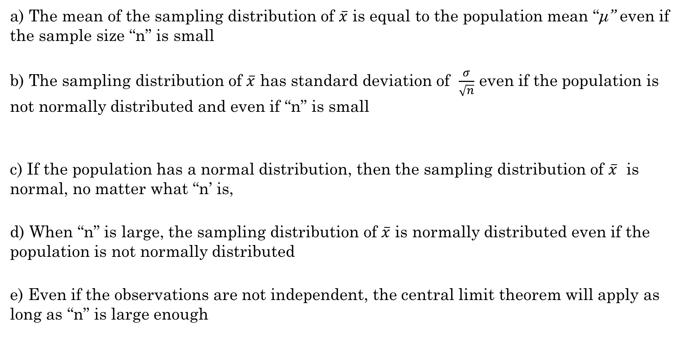
Which of the following statements is incorrect?
a) The mean of the sampling distribution of $\overline{x}$ is equal to the population mean “μ” even if the sample size “n” is small
b) The sampling distribution of $\overline{x}$ has standard deviation of $\frac{σ}{\sqrt{n}}$ even if the population is not normally distributed and even if “n” is small
c) If the population has a normal distribution, then the sampling distribution of $\overline{x}$ is normal, no matter what “n’ is,
d) When “n” is large, the sampling distribution of $\overline{x}$ is normally distributed even if the population is not normally distributed
e) Even if the observations are not independent, the central limit theorem will apply as long as “n” is large enough
True!
True! Parent distr. Of population does not be normally distr.!!
Since population is normal, sampling distribution of $\overline{x}$ will also be normal
This is the central limit theorem!
False, for the Central Limit THm. to apply, all the observations must be independent!

Slide 27
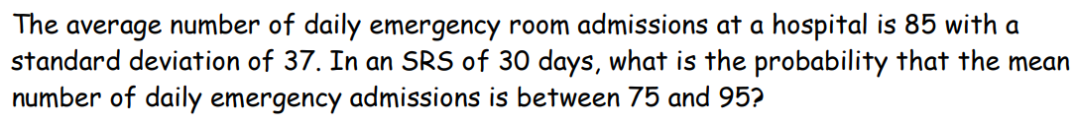
a) 13.88% b) 21.285 c) 86.12% d) 89.9% e) 99.7%
According to the Central Limit Thm, if the sample is n>30, then the distribution of the sample means will be normally distributed!

Slide 28
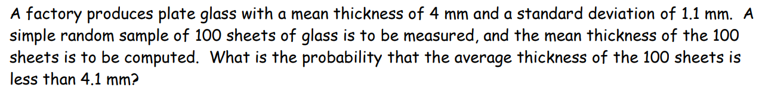
a) 81.83% b) 31.83% c) 18.14% d) 68.17% e) 50%

Slide 29
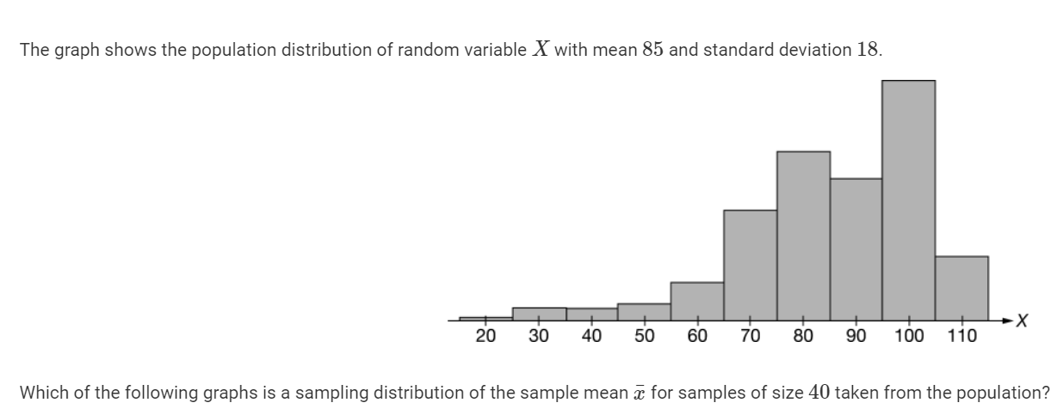
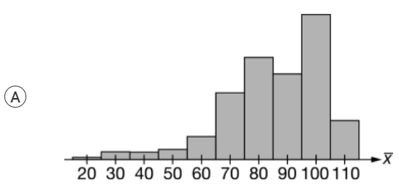
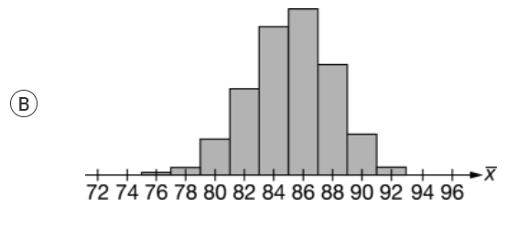
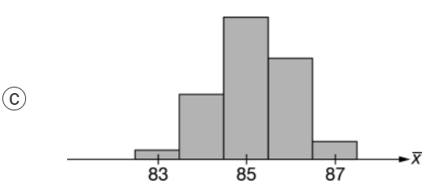
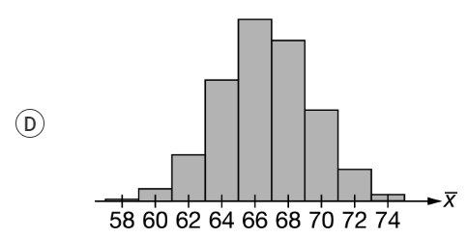
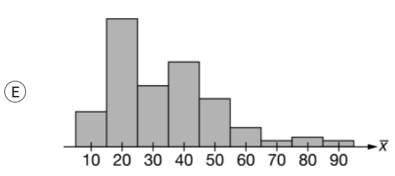

Slide 30
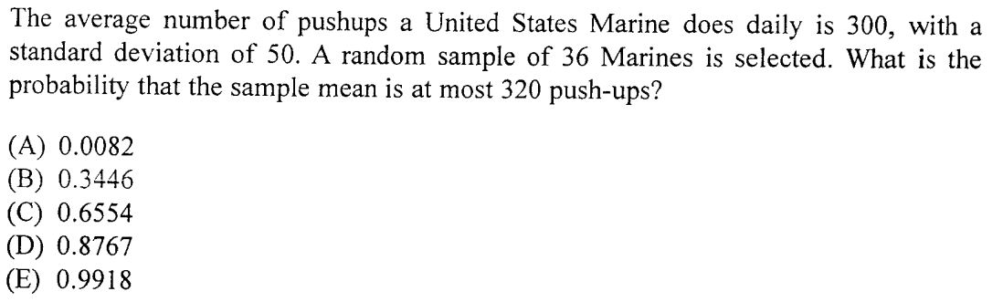

Slide 31
Why the standard deviation of the distribution of sample means equal to $\frac{σ}{\sqrt{n}}$
First let’s remember the rules for “combining” and “converting” random variables
If you are combining a group of random variables together, ie: A = B + C + D + E
The mean of “A” will be the sum of the means of B, C, D, and E
The variance of “A” will be the sum of the variance of B, C, D, and E
The Standard deviation of “A” will be the square root of the sum of the variance of B, C, D, and E
Now, let’s also review the rules for “converting” random variables ie: M = $\frac{1}{5}A$
When converting random variables, the standard deviation will be a direct multiplication with the constant

Slide 32
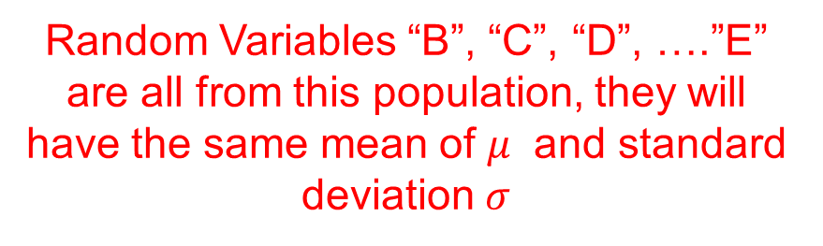
So, let “A” be the sample of size “n”, where “B”, “C”, “D”, ….”E” are all single units from the same population
Population Distribution
With a sample size of “n”, there are “n” means that can be added together
Random Variables “B”, “C”, “D”, ….”E” are all from this population, they will have the same mean of $μ$ and standard deviation $σ$

Slide 33
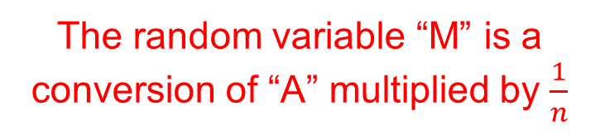
Now, let’s assign another random variable “M” that is equal to the average of the sample
The random variable “M” is a conversion of “A” multiplied by $\frac{1}{n}$
From the previous page
SIMPLIFY THIS!!
The mean of the distribution of the sample means is equal to the population mean!!!!!
AND the FAT LDY SINGS!!!

